Slide 1












AI Coding Assistants
Transforming Software Development
PRESENTED BY
[Shima Vosoogh
Gulpari Alandarova
[Rafia Riana
Presenter 1
Presenter 2
Course CEP146
Instructor Professor Raymond Wong
Date Summer2026

Slide 2
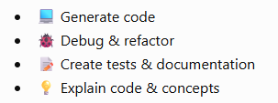
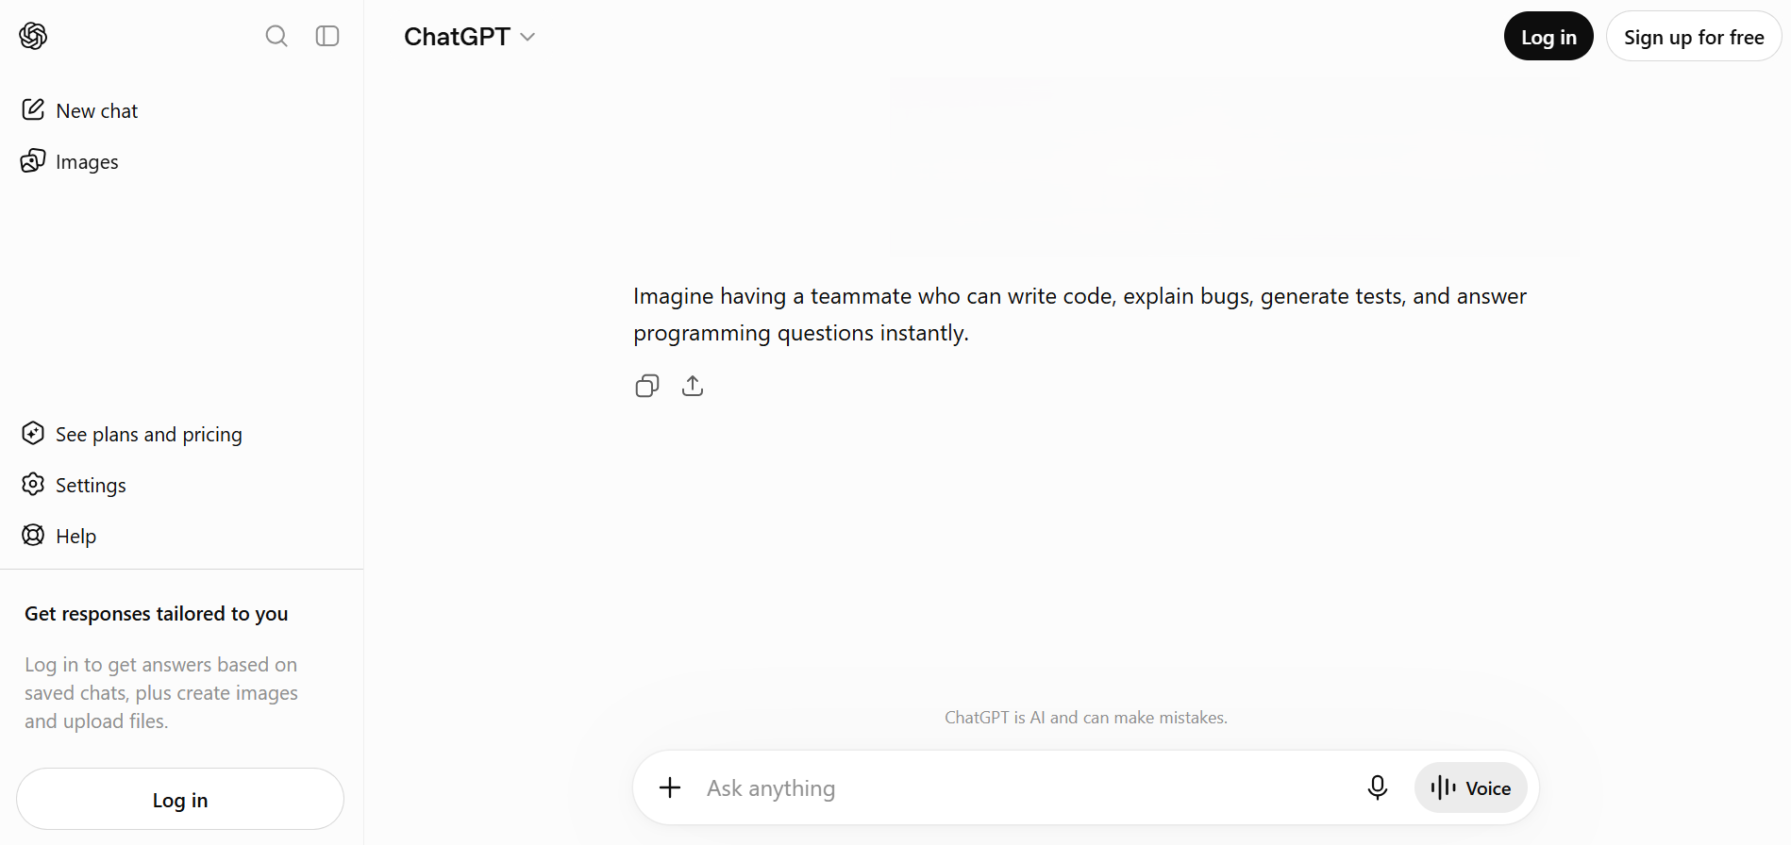
Would You Hire a Junior Developer Who Never Sleeps?
What Are AI Coding Assistants?
Software development is no longer just about writing code—it's increasingly about collaborating with AI. AI coding assistants help developers generate, debug, explain, and improve code, making software development faster and more efficient.

Slide 3




The Evolution of AI Coding Tools
GEN 1 (Pre-2020)
Rule-Based Autocomplete
GEN 4 (2025–2026)
Syntax-aware suggestions using predefined language rules.
Traditional IDE autocomplete
Language & syntax completion
No understanding of developer intent
Agentic AI
AI autonomously executes development tasks from start to finish.
Autonomous coding
Testing & debugging
Workflow automation
GEN 2 (2021)
LLM-Powered Coding
Large Language Models introduced natural language code generation.
GitHub Copilot
Prompt-to-code generation
AI-assisted code completion
GEN 3 (2023–2024)
Context-Aware Assistants
AI understands your project, not just the current file.
Chat-based coding
Project-wide context
Multi-file editing

Slide 4
The Old Way vs. Today
Before AI: With AI:
💡 Idea 💡 Idea
│ │
▼ ▼
🔍 Search 🤖 Ask AI
│ │
▼ ▼
📚 Documentation 💻 Generate code
│ │
▼ ▼
💬 Stack Overflow 🔍 Review
│ │
▼ ▼
⌨️ Code 🚀 Deliver
Tools | Primary Strength
GitHub Copilot | IDE code completion
ChatGPT | Reasoning & debugging
Cursor | Repository-wide editing
Claude Code | Long-context & agentic workflows
Gemini Code Assist | Google Cloud development
Amazon Q Developer | AWS development
Less searching → More problem-solving

Slide 5
What AI Can Do
💻 Generate code
🐞 Find bugs
🧪 Write tests
📚 Explain code
"AI acts like a coding partner. It can generate code, explain unfamiliar functions, help debug errors, and even create unit tests."

Slide 6
"AI is fast, but it doesn't truly understand your project or your users. Developers still need to review and guide its output."

Slide 7
"The future isn't AI replacing developers. It's developers who know how to work effectively with AI becoming more productive.“
"AI coding assistants are changing software development by handling routine tasks, allowing developers to focus on creativity, problem-solving, and building better software."

